Slide 1
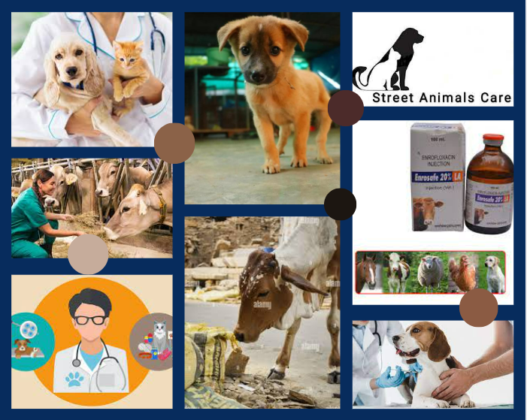

Slide 2

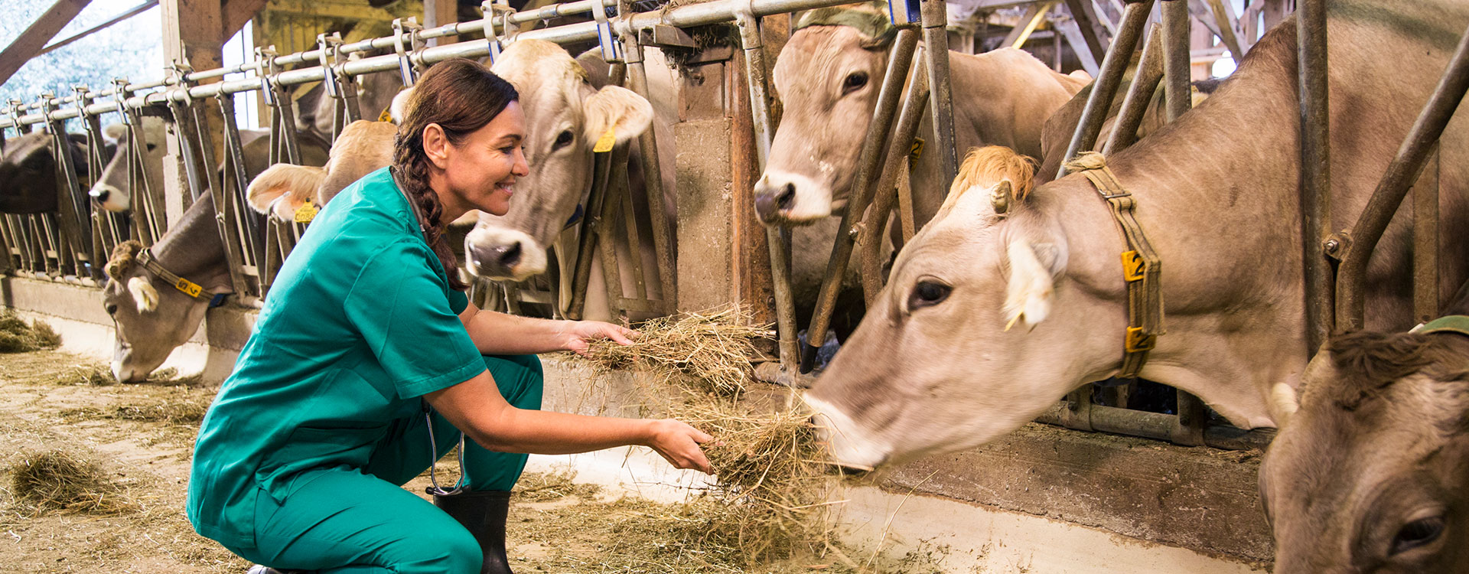
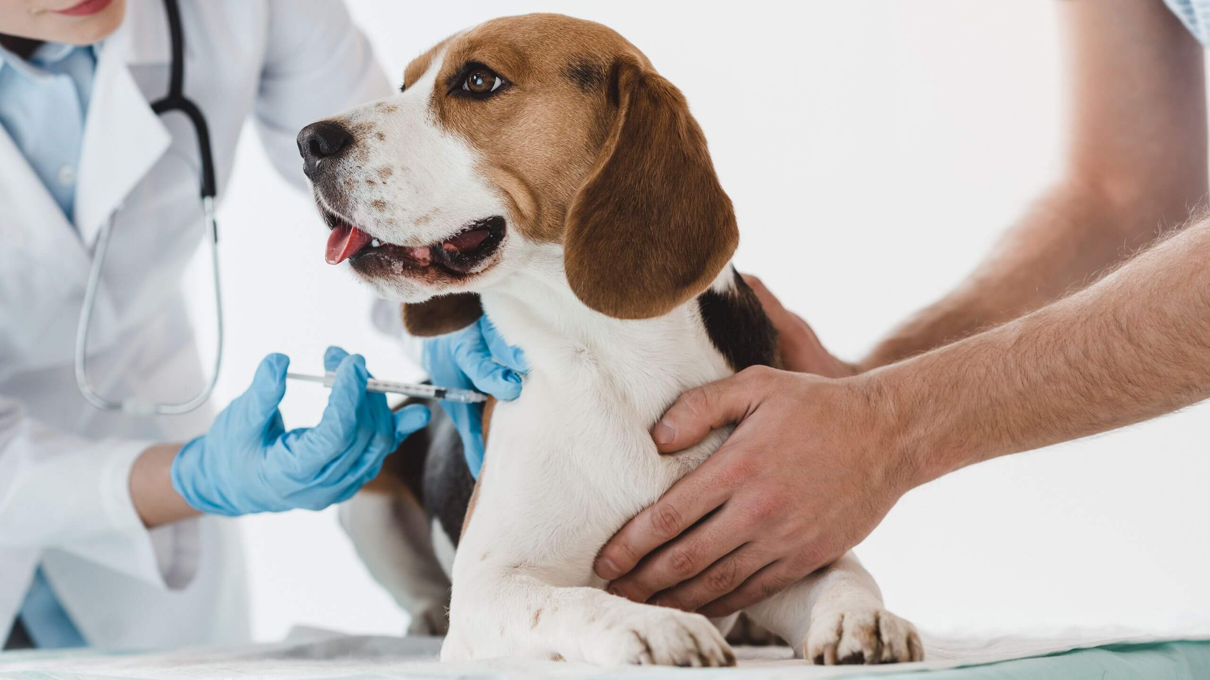
Group-106
Phase-1-Review

Slide 3
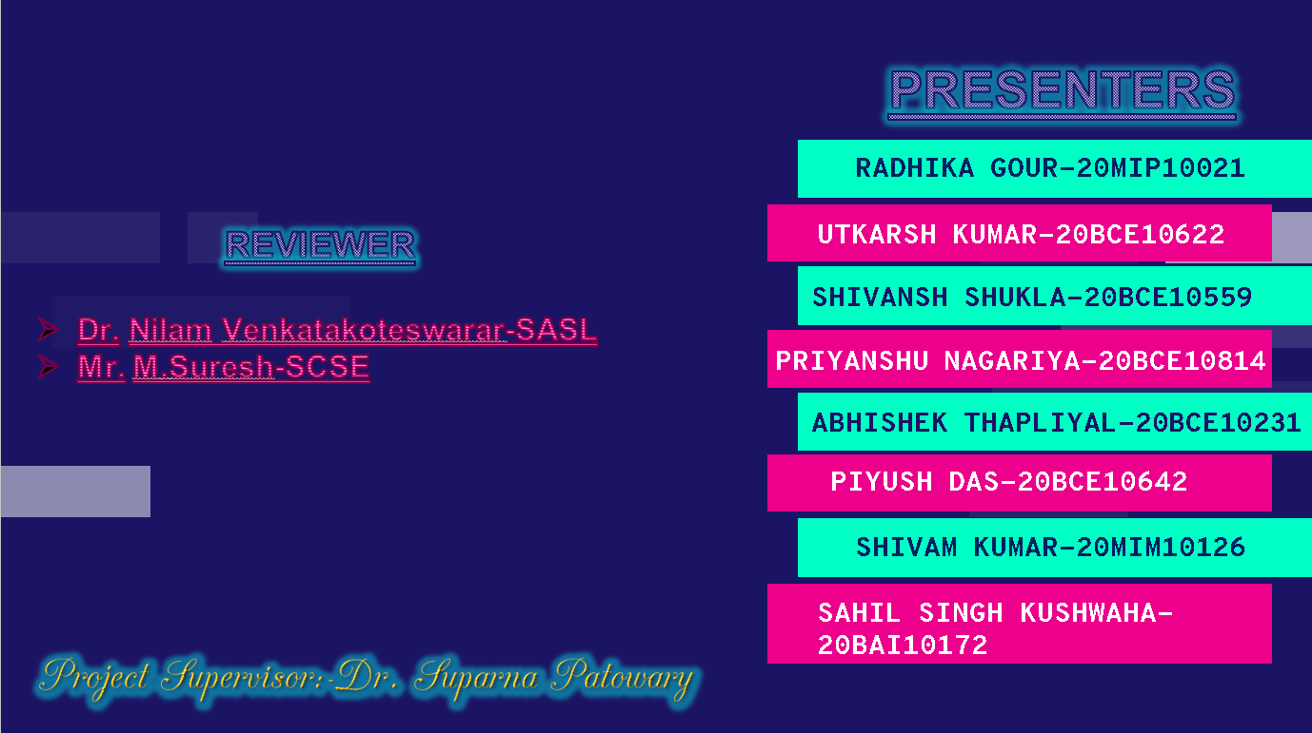

Slide 4









Introduction/Problem Statement/Objectives
Architecture Diagram
Literature Review & Proposed System
Working Principle
Animal HealthCare
.
First Look of the Website
Novelty & Real Time Usage
System Requirement
Conclusion
Upcoming Works

Slide 5

INTRODUCTION
Animal healthcare is a environment for animals that enables us to offer them all the amenities in one location. From the time of an animal's birth until the time of its death, we offer all the necessary assistance in this service-providing environment. This includes providing any animal with all necessary medical treatment as well as mentoring and physical, mental, and emotional support. For active use, professionals including doctors, dieticians, trainers, and NGOs are accessible. This will give people a fantastic opportunity to take care of their pets.

Slide 6


LITERATURE REVIEW
Many people have made it a priority to help animals by giving them food, shelter, and medical care on their own. Private funding is being done for animal aid, and government NGOS are also making a lot of effort to help as much as they can. However, the absence of such a setting , Animal HealthCare, is preventing them from completing their mission; as a result, we are building a bridge that unites all those who are willing to assist to the animals that need it.

Slide 7


PROBLEM STATEMENT
Regular death of street animals due to many external factors.
Unavailability of good doctors, dieticians, prescribed medicines in nearby areas.
NGOs facing problem in helping out animals and raising funds.
Local food Producers are facing problem to sell out their products due to lack of advertisement.

Slide 8
LIMITATIONS OF EXISTING SYSTEM
It is difficult to find pet related medical-facilities in India.
It is not easy to find information regarding domestic animals.
Finding people interested in adoption of animals is very hectic work.
Finding pet trainers is not an easy task.
Information regarding urgent medical aid is not easily available on the internet.

Slide 9

OBJECTIVES
To reach out all animals who need help.
To provide better healthCare facilities to animal.
To reduce a death ratio of street animals.
To provide shelters to street animals.
To provide dieticians,trainers,doctors to pet owners.
To give information to NGO's about ownerless
animals.
To help people who are making animal product by
allowing them to sell the product to website.

Slide 10





ADVANTAGE OF OUR PROPOSED SYSTEM
Better HealthCare facilities of animal.
Help to local producers producing animal products.
Help NGOs to raise funds.
Provide Shelter to unowned animals.
Help the pet owner to get all facilities at one place.

Slide 11




NOVELTY OF THE PROJECT
The uniqueness of the project is that we are providing an interface to any person who is willing to help stray animals and directly connecting them to NGO’s.

Slide 12
REAL TIME USAGE
Any person using our website can upload a picture of any animal according to the need, food, shelter and medical facility will be provided.
People working for welfare of animals will get a platform to perform the activities.
Local people making animal product will get a platform to advertise their products.
A noble cause to protect animal.

Slide 13
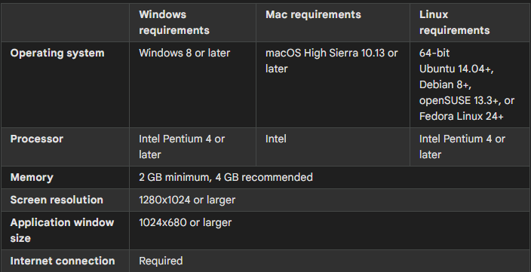


SYSTEM REQUIREMENT

Slide 14
WORKING PRINCIPLE
The picture taken by the user is uploaded and stored in the database which is then visible to the people and organizations linked to our website like doctors, dietitians, NGOs who provide all the possible solutions to the user according to themselves considering the situation of the injured animal. In case, a user finds a dead animal he can call for a last ride which on detecting his location provides the determined facilities.

Slide 15
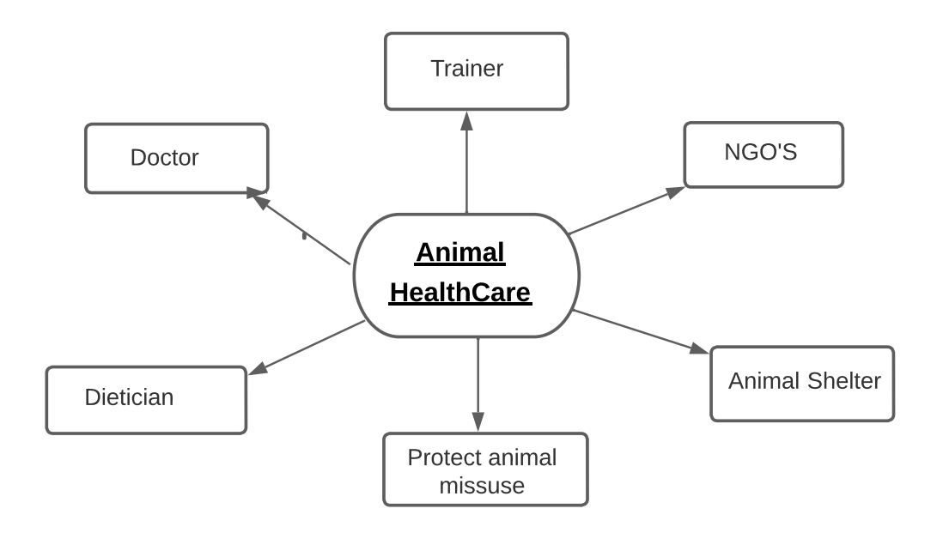
ARCHITECTURE DIAGRAM

Slide 16

FIRST LOOK

Slide 17
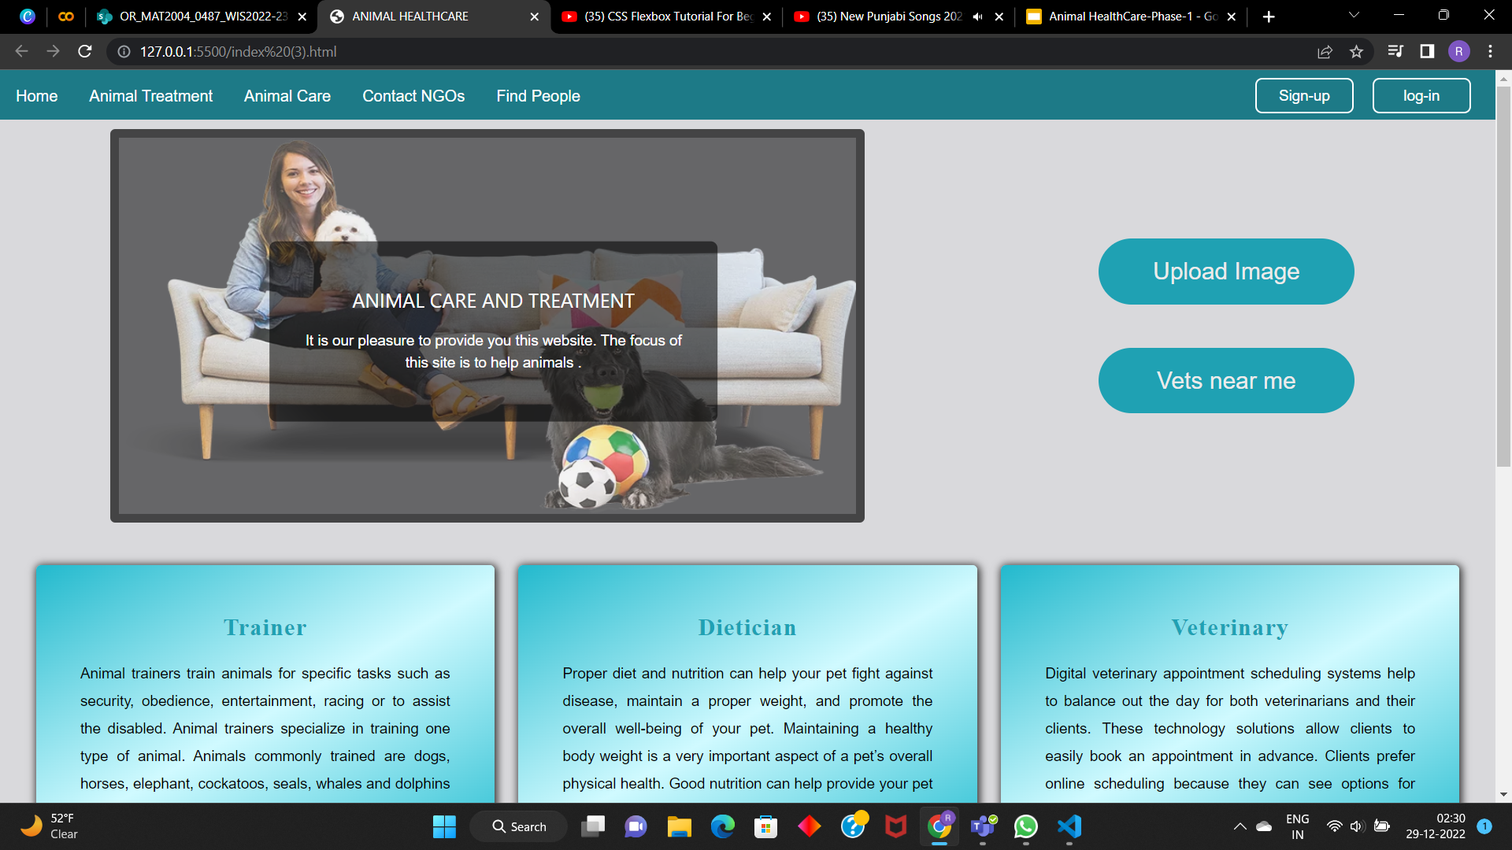

Slide 18
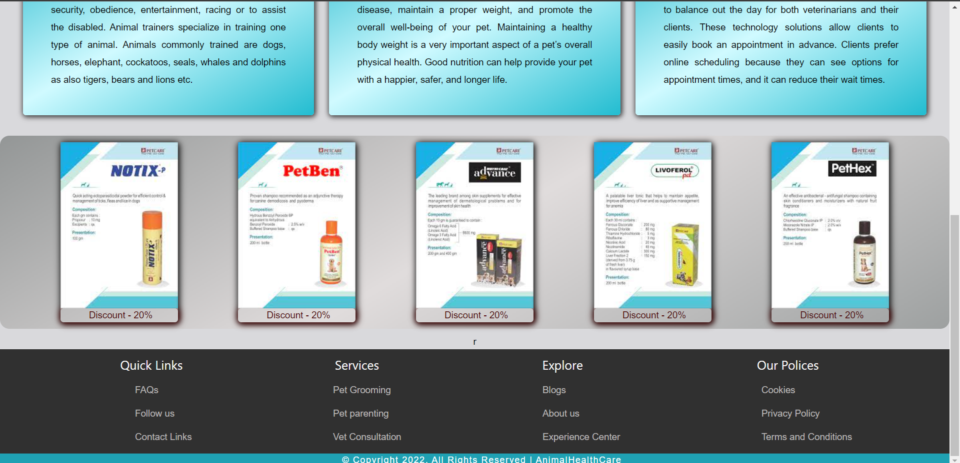

Slide 19
CONCLUSION
There is a need in society for an ecosystem that can support all animals in a variety of ways in one location. We are attempting to create this environment through web development by enabling users to access all animal-related services.
We are also doing our best to address the issue of street animals. Although there are many NGOs working for the welfare of animals in our society, many animals are still missed, so we are building a bridge to link all the missing animals to the NGO's. We also give users the ability to upload their animal-related products. As a result, both the consumer and the producer can satisfy every requirement.

Slide 20
Upcoming Work
Appointing doctors, NGO’s, Trainers, Producers and dieticians
We are going to implement the backend of our website.
We will also work on App related to our project.

Slide 21

THANK YOU

